Slide 1
Hybrid Car- Base Pro Plus II
By: Izzy Cozier, Heston Wilson, and Jackson Roberts
Notes:
JACKSON

Slide 2
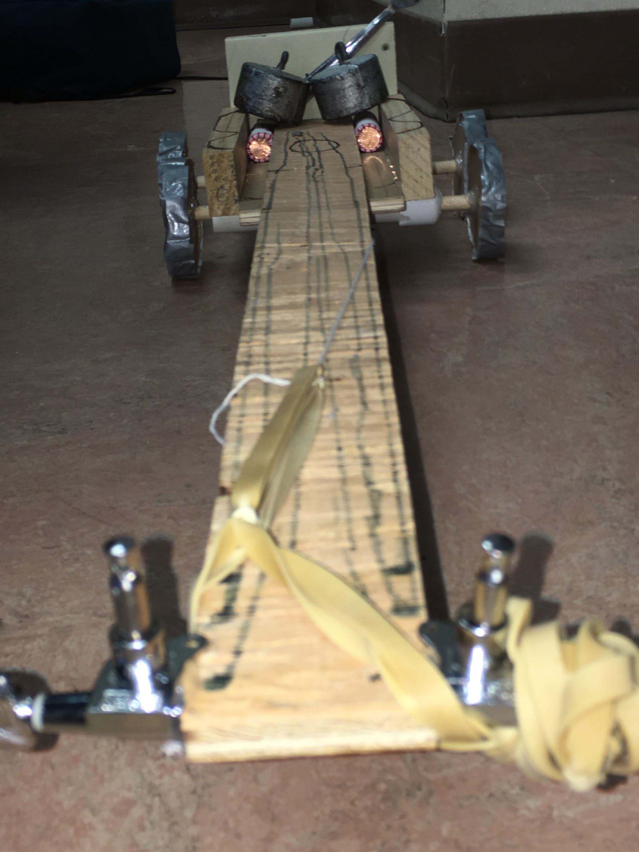
Notes:
HESTON

Slide 3
The Thought Behind Our Car
At first we thought we wanted to go for a unique idea of building a water bottle car. Until we realized the car had to hold a dollar worth of pennies.
We decided to go for a car that was powered by a rubber band and a string around the axle. After building our machine we designed it to represent a guitar because of the long piece of plywood sticking off the end of our car.
Notes:
IZZY

Slide 4
Our Design
Solid cardboard wheels reinforced with duct tape for strength and grip
2 masses weighing 500 g each
4 circle shaped tires with a diameter of 3 inches
28x2 inch piece of plywood used to attach our rubber bands to
2 sets of 2 rubber bands tied together
2 PVC pipes underneath our car to hold wooden dowels attached to the wheels
Designed as a guitar with tuners on the side and drawn strings
Notes:
JACKSON

Slide 5
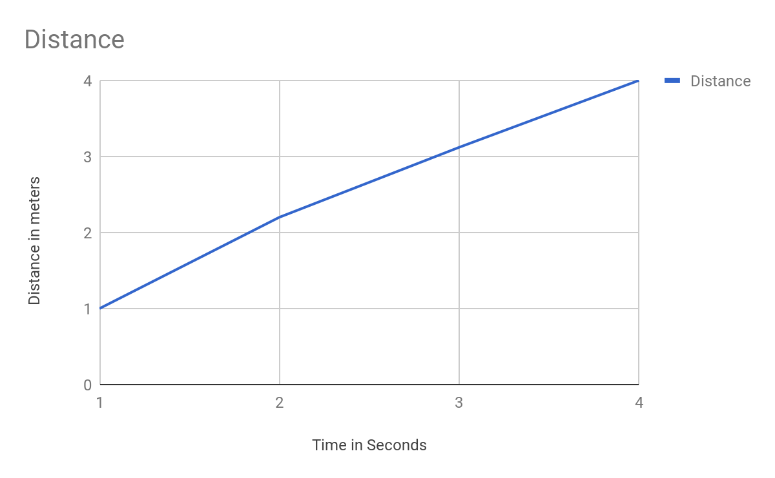
Distance Vs Time Graph
Notes:
HESTON

Slide 6
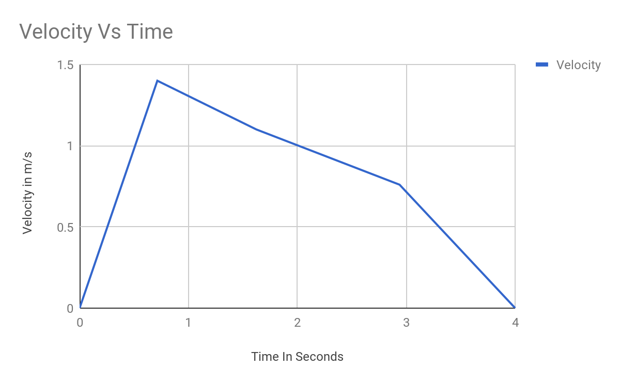
Notes:
HESTON

Slide 7
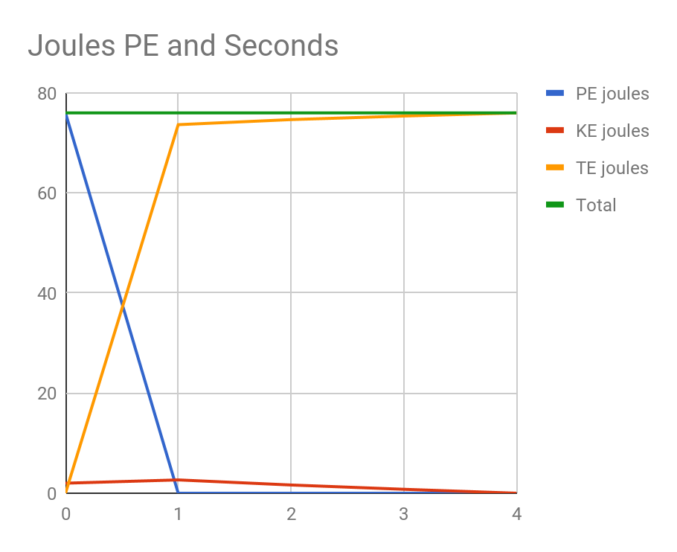
Energy Vs Time
Notes:
HESTON

Slide 8
Cost to construct our Car
22$
Wood:$15-20
Wood axles = less than $1
Duct Tape: free
Cardboard wheels: $1
Other: Negligible price.
Notes:
JACKSON

Slide 9
Selling Points
Inexpensive Design
Great for Musicians
Reliable car
Includes a fork to use for eating purposes or other things
Wheels enhanced with duct tape for grip
Basic design, easy to build
Safety features including a backboard and masses on top of our pennies to keep them secure
Does not require fuel of any kind
Notes:
JACKSON

Slide 10
Increase/Decrease of Friction
Adding duct tape onto our wheels helped our wheels have better grip and decreased the amount of friction because the duct tape made the wheels move more smoothly
The two 500 g masses increase the amount of friction by making the force exerted onto the ground weigh more
This increase of Force down, onto the ground, makes the wheels go forward with roughness
Notes:
IZZY

Slide 11
Thanks for Watching!!!
Notes:
IZZY

